Slide 1
Data Science talent management Solutions
Limin Zheng
DDS Analytics

Slide 2
Background
Employee replacement cost 50-60% of annual salary, total turnover can go up to 200%
Employee Retention Strategies: pinpoint the root cause
Data Science in talent management

Slide 3
Summary of Project
Attrition: 140 (Yes) 730 (No)
Variables (35): ID, Age, Gender, MaritalStatus, MonthlyIncome, JobLevel,JobRole, JobSatisfication, OverTime, WorkLifeBalance, BusinesssTravel, YearsInCurrentRole, YearsSinceLastPromotion, RelationshipSatisfication, PercentSalaryHike, etc
Objective 1: Attrition Prediction.
Objective 2: Salary Prediction

Slide 4
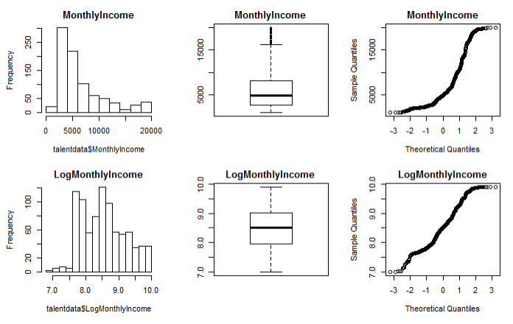
Exploratory Data Analysis

Slide 5
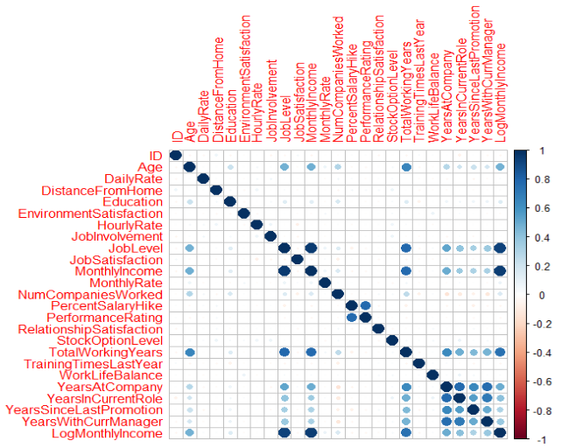
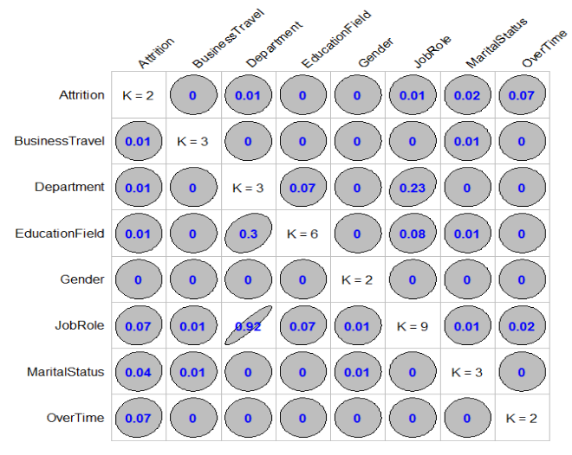
Exploratory Data Analysis
Correlation plot of continuous variables
Correlation plot of categorical variables

Slide 6
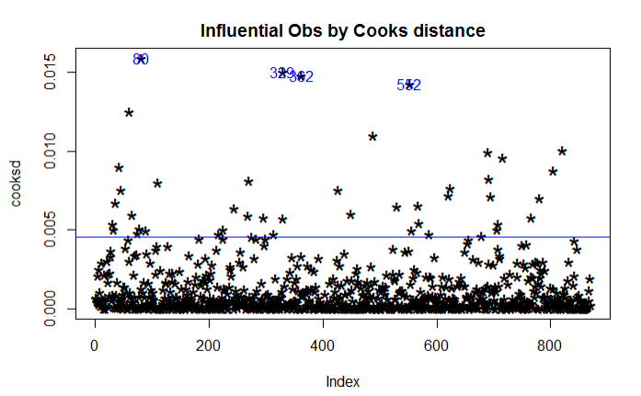
Exploratory Data Analysis

Slide 7
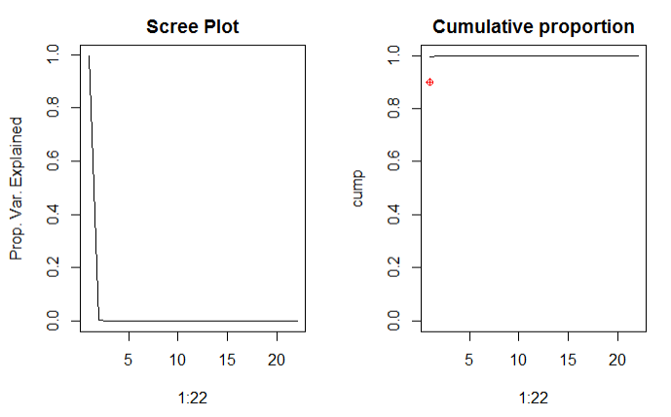
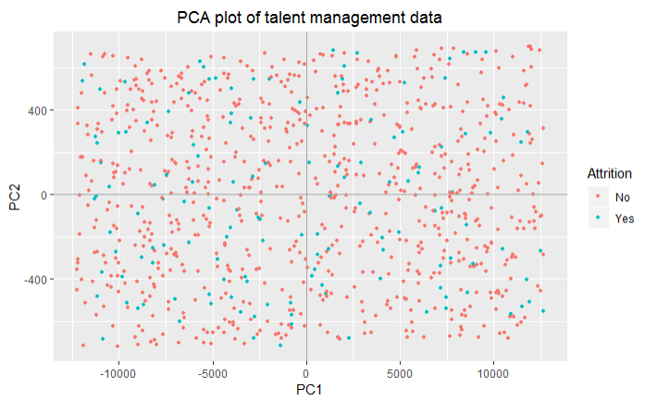
Exploratory Data Analysis

Slide 8
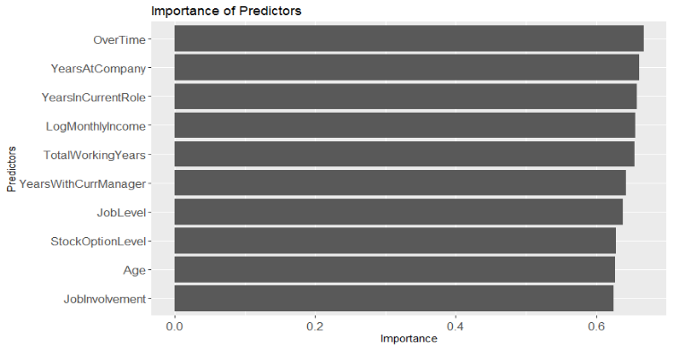
Objective 1 Predict Attrition

Slide 9
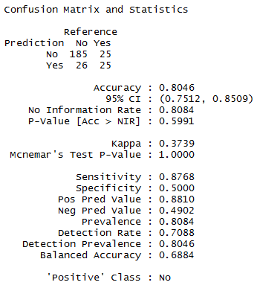
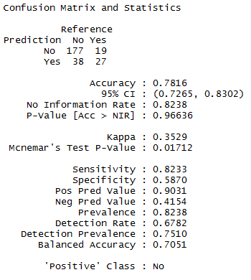
Objective 1 Predict Attrition
Naïve Bayes model fitting with all predictors
Customized Naïve Bayes model fitting

Slide 10
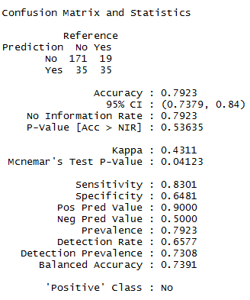
Objective 1 Predict Attrition
Naïve Bayes model fitting after outlier removal

Slide 11
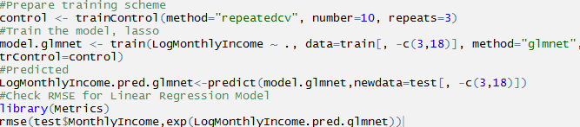
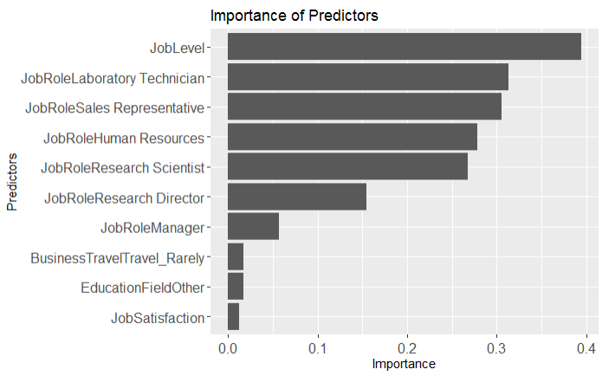
Objective 2 Predict Salary

Slide 12

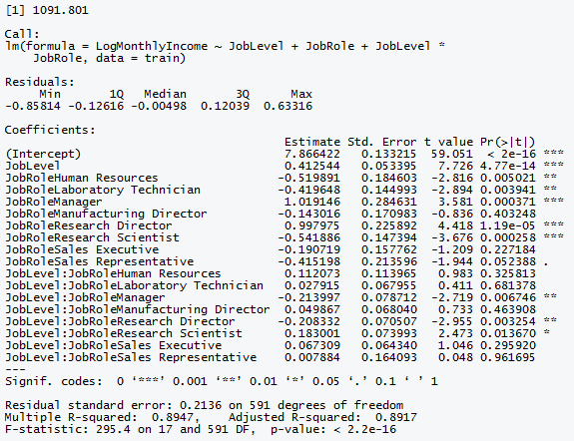
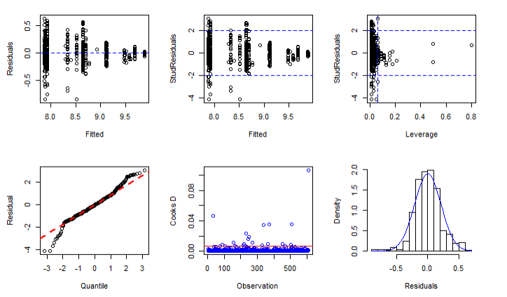
Objective 2 Predict Salary

Slide 13
Thank you

